Slide 1
Chapter 1 Introduction to Computer Networks
BIS416E – Networks & Security
Dr. Omayma Younis

Slide 2
Learning Objectives
Understand what is a computer network, and identify its purpose.
Explain and distinguish the types of networks from different perspectives.
Determine the hardware components for installing a computer network.

Slide 3
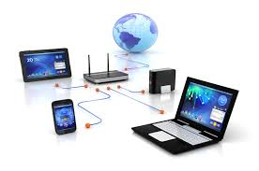
What is a Computer Network?
A network is composed of two or more devices (nodes) connected together, and they can communicate for the purpose of sharing resources.
The generic term “node” or “host” refers to any device on a network (e.g. computer, mobile, printer, router, switch, etc.)

Slide 4
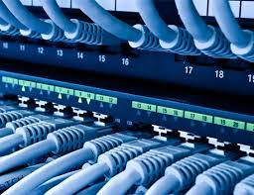
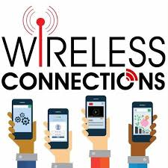
What is a Computer Network?
From the definition, a computer network is characterized by:
Connectivity Communication Resources-sharing
Connectivity: nodes can be linked via wired connections (e.g. network cables, telephone lines), or via wireless connections (e.g. radio waves, microwaves, satellites, infrared light beams, etc).

Slide 5
What is a Computer Network?
Communication: data is transferred between connected nodes using communication protocols (e.g. TCP/IP, HTTP, FTP, …).
Resources-sharing: nodes share hardware resources (e.g. printer, disc drive), as well as software resources (e.g. files, programs, folders).

Slide 6
Understanding Networking Jobs
Network Administrator:
Creating, maintaining and removing users accounts.
Managing network security policies.
Adding new networking equipment, such as servers, routers, hubs, and switches, and managing that equipment.
Monitoring the network, its hardware , and software for potential problems and for utilization levels for planning network upgrades.

Slide 7
Understanding Networking Jobs
Troubleshooting network problems.
Ensure that necessary backups are made, such as administrative accounts and their passwords.
Network Engineer:
More deeply involved in the bits and bytes of a network.
Usually troubleshoot and fix the problems that surpass the ability of the network administrator to resolve.

Slide 8
Understanding Networking Jobs
Holding a degree in electrical engineering or computer science and carry certifications from networking equipment companies.
Network Designer:
Work for companies that sell and support networks for organizations with large networks.
They must know the business requirements that the network needs to meet and also understanding of all the networking products available, as well as the product interact.

Slide 9
Understanding Networking Jobs
Other Network- Related Jobs:
including some that don’t involve working directly with a network (e.g database administrator, web designers, e-mail administrators, etc.)

Slide 10
Networks Types
Computer networks can be classified from different perspectives, such as:
Transmission Media: Wired media (Twisted-pair, coaxial, fiber-optic cables) and Wireless media.
Network Size: LAN, MAN, WAN, …
Network Architecture: Peer-to-Peer and Client/Server.
Network Topology (configuration): Bus, Star, Ring, Mesh, …

Slide 11
Transmission Media
Two main categories of transmission media:
Wired Transmission Media: nodes are connected via wires / cables.
Twisted pair cables (UTP & STP)
Coaxial cables
Fiber optic cables
Wireless Transmission Media: nodes are connected via wireless links.
Microwaves
Radio waves
Infrared & Bluetooth waves

Slide 12
Transmission Media
A. Wired Transmission Media (Physical cabling):
Twisted-Pair Cables:
Cheapest transmission media and the most widely used.
Good for short distances (up to 100 meters); requires repeaters for longer distances.
Typically, four pairs of copper wires are bundled together in a cable:
- Orange & White-Orange - Green & White-Green
- Blue & White-Blue - Brown & White-Brown
Typically, twisted pair cables are terminated with an RJ-45 connector.

Slide 13
Transmission Media
A. Wired Transmission Media (Physical cabling):
Twisted-Pair Cables:
Two types of twisted pair cables:
Unshielded Twisted Pair (UTP): CAT1, CAT2, CAT3, CAT4, CAT5, CAT5e, CAT6.
Shielded Twisted Pair (STP).
UTP and STP cables are the same, except that STP cables have a metal foil (shield) that covers each pair of insulated wires. This makes STP cables more resistant to external electromagnetic interference.

Slide 14
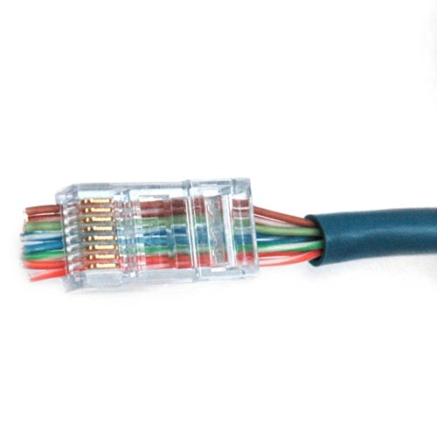
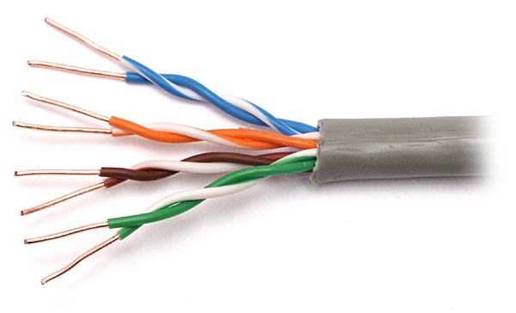
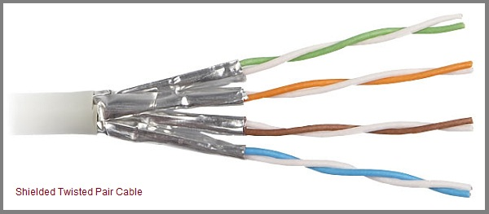
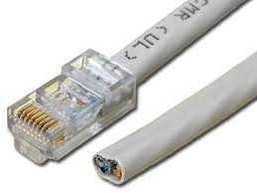
Transmission Media
Unshielded Twisted Pair (UTP)
Shielded Twisted Pair (STP)
RJ-45 Connecter for Twisted Pair Cables

Slide 15
Transmission Media
A. Wired Transmission Media (Physical cabling):
Coaxial Cables:
Much resistant to interference than twisted-pair cables.
Common in TV cables (receivers).
Can be used over longer distances than twisted pair cables.
Requires repeaters every few kilometers for digital transmission.
Typically, coaxial cables are terminated with a BNC connector, and such cables are connected to each other via a BNC-T connector.

Slide 16
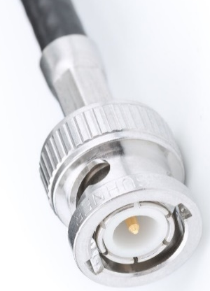
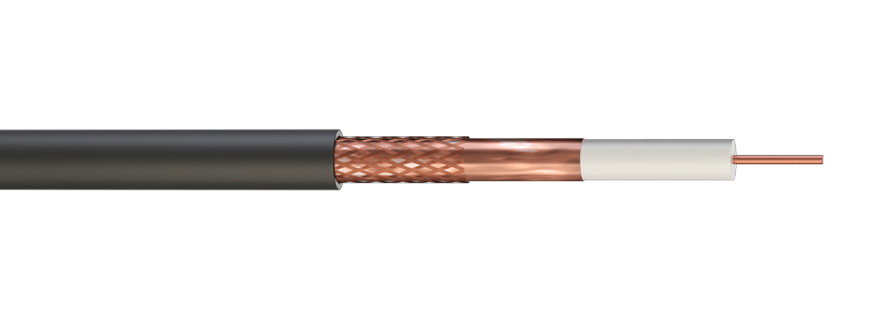
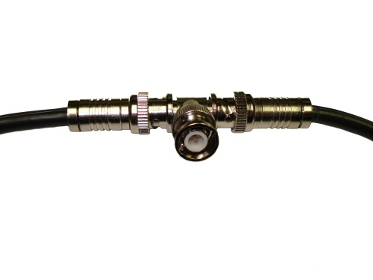
Transmission Media
Copper wire (center core)
Plastic Insulator
Metallic Wrapping (2nd Conductor)
BNC connector for Coaxial cables
Plastic Cover
Coaxial Cable
BNC-T connector for joining several coaxial cables

Slide 17
Transmission Media
A. Wired Transmission Media (Physical cabling):
Fiber Optic cables:
Much higher bandwidth (i.e. speed).
It can carry hundreds of Gbps over tens of Kilometers.
Significantly lower signal degradation (i.e. high resistance to interference).
Very expensive and hard to install.
Typically, fiber optic cables are terminated with LC, FC, SC, or ST connectors

Slide 18
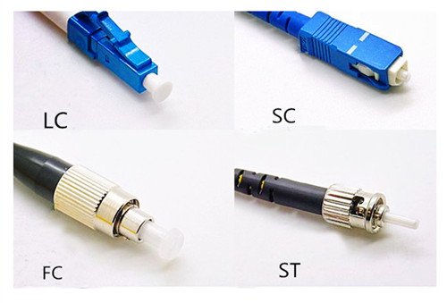
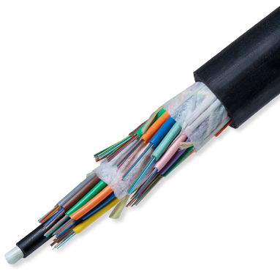
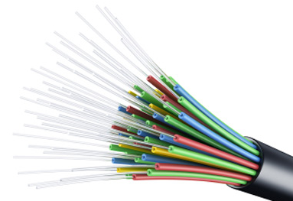
Transmission Media
Different types of connectors for fiber optic cables
Fiber Optic Cable

Slide 19
Transmission Media
 | Twisted Pair | Coaxial | Fiber Optic
Data Transfer Rate | UTP: 10 ~ 1000 Mbps STP: 10 ~ 100 Mbps | 10 ~ 100 Mbps | 1 ~ 100 Gbps
Connector Type | RJ-45 | BNC & BNC-T | Most common types: FC, LC, SC, and ST
Cost | Cheap | Moderate | Expensive
Interference Resistance | Least Resistant | Moderate | Most resistant
Signal Degradation | High | Moderate | Low
Distance Limit | Short (up to 100 meters) | Medium (up to few kilometers) | Long (up to tens of kilometers)

Slide 20
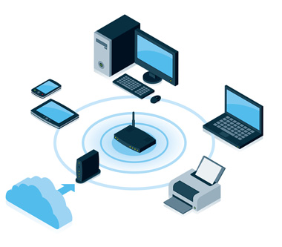
Transmission Media
A. Wireless Transmission Media:
Wireless signals are electromagnetic waves that can travel through the vacuum of outer space and through a medium such as air.
No physical medium is necessary for wireless signals. (Unguided Media)
Wireless networks typically use microwaves (e.g. 2.4 GHz), radio waves (e.g. 902 MHz), and IR waves (e.g. 820 nanometers) for communication.

Slide 21
Transmission Media
A. Wireless Transmission Media:
Some common applications of wireless data communication include:
Accessing the Internet using a cellular phone (e.g. 4G, 5G)
Establishing a home or business Internet connection over satellite
Beaming data between two hand-held computing devices

Slide 22
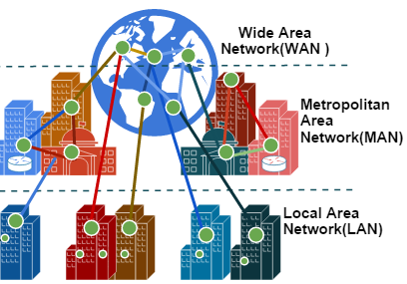
2. Size of Network
The main categories of networks size include:
Local Area Network (LAN)
Metropolitan Area Network (MAN)
Wide Area Network (WAN)

Slide 23
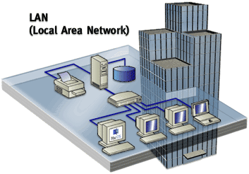
2. Size of Network
Local Area Network (LAN):
Nodes are connected within small geographic regions (e.g. across room, floor, building).

Slide 24
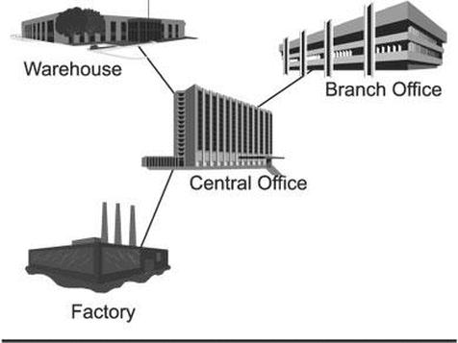
2. Size of Network
B. Metropolitan Area Network (MAN):
Nodes are connected within larger geographic regions (e.g. across town, or small city).

Slide 25
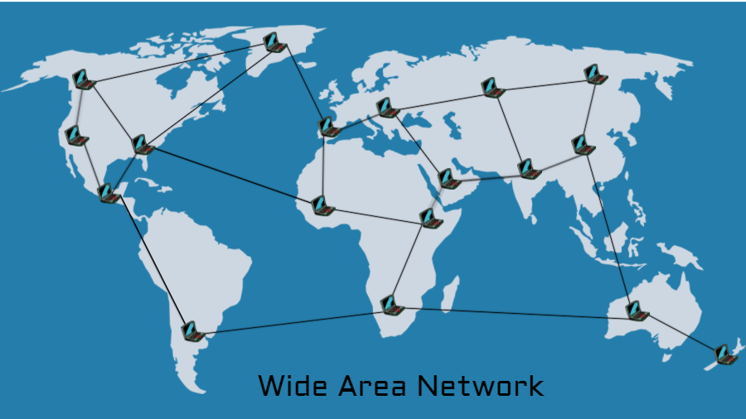
2. Size of Network
C. Wide Area Network (WAN):
Nodes are connected within widely-broad geographic regions (e.g. across country, continent, world).
The Internet is the most popular example of a WAN.

Slide 26
3. Network Architecture
The relationship between the communicating nodes in a network can be organized in two different ways:
Peer-to-peer network
Client/Server network

Slide 27
3. Network Architecture
A. Peer-to-Peer:
Most common in home networks, or small LANs.
In a typical peer-to-peer network, every computer is a peer (equal) within the network.
Each computer can function as both client and server (i.e. any device can send and receive requests within the network).
Each computer is responsible for:
Making its own resources available to other peers.
Maintaining its own security (permissions) for these resources.

Slide 28
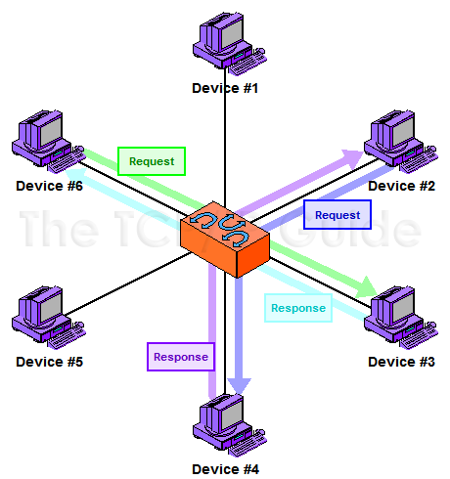
3. Network Architecture
A. Peer-to-Peer:

Slide 29
3. Network Architecture
B. Client/Server model:
Most common in large area networks (e.g. large LANs, MANs, WANs)
One computer (or a few of them) are designated as centralized servers and are given the task of providing services/resources to a larger number of user machines called clients.
Server: computer that provides the resources necessary to other computers (e.g. documents printing, sharing files, etc.).
Client: computer that normally requests and receives information over the network.

Slide 30
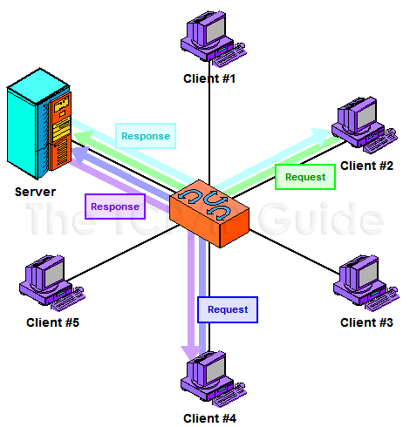
3. Network Architecture
B. Client/Server model:
Resources are allocated at the Server

Slide 31
4. Network Topology
Network topology: refers to the configuration of which the nodes are connected. Various topologies have been used to administer networks:
Bus Topology
Star Topology
Ring Topology
Mesh Topology

Slide 32
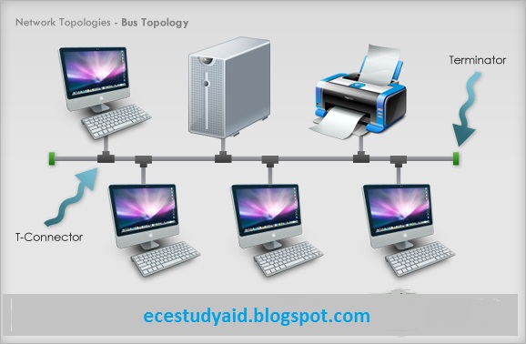
4. Network Topology
A. Bus Topology: A configuration in which all nodes are connected to a single communication cable that carries messages in both directions.

Slide 33
4. Network Topology
Bus Topology:
It is the simplest network topology. It consists of a single cable (trunk) that runs to every workstation (node). Only one computer can send a message at a time.
This topology uses the least amount of cabling, but also covers the shortest amount of distance.
If the cable (trunk) is damaged, the whole network fails.
Each computer shares the same data and address path. With a bus topology, messages pass through the trunk, and each workstation checks to see if the message is addressed to itself. If the address of the message matches the workstation’s address, the network adapter copies the message to the card’s on-board memory.

Slide 34
4. Network Topology
Bus Topology:
Advantages | Disadvantages
Cheap and easy to install Needs least cabling requirements Best suited for small networks | Limits number of nodes that can be connected Difficult to add nodes to existing network If the cable breaks, the network fails

Slide 35
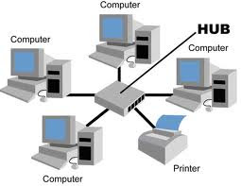
4. Network Topology
B. Star Topology: A configuration that centers around a hub/switch to which all nodes are connected, and through which all messages are sent.
Switch

Slide 36
4. Network Topology
B. Star Topology:
The most common type of topologies in LANs.
A star topology connects each device to a central device called a hub (or switch), making it very easy to add a new workstation (node).
All data transferred from one computer to another passes through the hub/switch.
If any workstation goes down it does not affect the entire network. But, as you might expect, if the hub/switch goes down, the entire network goes down.
Depending on the intelligence of hub/switch, two or more computers may send message at the same time.

Slide 37
4. Network Topology
B. Star Topology:
Advantages | Disadvantages
Easy to install and wire. Easier to expand than a bus or ring topology. If a workstation cable breaks, the network still works (fault-tolerant). | Requires more cable length than a bus topology. If the hub/switch fails, the network breaks down. More expensive than bus topology because of the cost of the hubs/switches.

Slide 38
4. Network Topology
C. Ring Topology: A configuration that connects all nodes in a closed loop on which messages travel in one direction via token passing.
Each computer is connected to two other neighboring computers, creating a unidirectional path where messages move from one node to another.
Each entity participating in the ring reads a message, then regenerates it and hands it to its neighbor on a different network cable, until it reaches the desired destination.

Slide 39
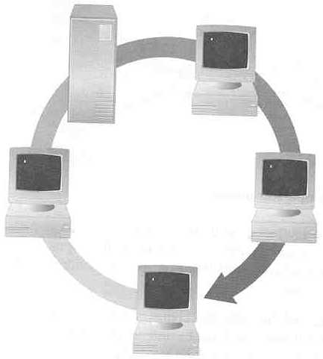
4. Network Topology
C. Ring Topology:
Typical way to send data is Token Passing:
Token moves in turn between the connected nodes (A, B, C, D, and E).
Computer (A) wishing to send data should wait until it gets the token. The computer which gets the token is given the right to send data.
When data is received by the desired destination (C), it sends an acknowledgment to the source (A).
A
B
Ack
T
T
T
T
T
data
data
data
data
T
data
E
waiting
C
T
T
T
Ack
T
D
T
data
Ack
T
T
Ack

Slide 40
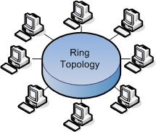
4. Network Topology
C. Ring Topology:
Note:
As long as the token is carrying a message (i.e. Data or Ack), no computer will be able to send anything. It should wait until the token is free.

Slide 41
4. Network Topology
C. Ring Topology:
Advantages | Disadvantages
Very orderly network where every device has access to the token and the opportunity to transmit. Easier to mange than bus network. Good communication over long distances. Handles high volume of traffic. | The failure of a single node of the network will cause the entire network to fail. The movement or changes made to network nodes affects the performance of the entire network.

Slide 42
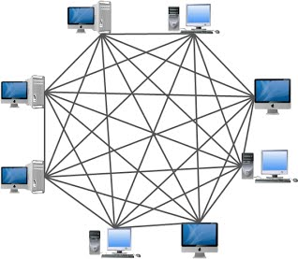
4. Network Topology
D. Mesh Topology: A configuration in which each node is connected to every other node.
The mesh topology is the simplest topology in terms of data flow, but it is the most complex in terms of physical design.
If there are n computers, there will be (n × (n–1)) ÷ 2 cables in the network.
Imagine how the person doing the cabling would feel if you told him you had to cable 50 computers in a mesh network. He’d have to come up with 50 × (50 – 1) ÷ 2 = 1225 cables!

Slide 43
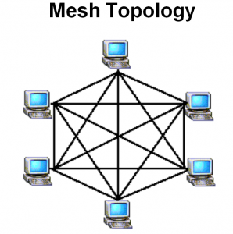
4. Network Topology
D. Mesh Topology:
Because of its design, the physical mesh topology is very expensive to install and maintain.
The main advantage is its high fault tolerance (i.e. network is not affected if one of the cables breaks down).
With a mesh topology, however, there will always be a way of getting the data from source to destination (indirect routing).
It may not be able to take the direct route, but it can take an alternate, indirect route. It is for this reason that the mesh topology is still found in WANs to connect multiple sites across WAN links. It uses devices called routers to search multiple routes through the mesh and determine the best path.

Slide 44
4. Network Topology
D. Mesh Topology:
Advantages | Disadvantages
Figure it out ☺

Slide 45
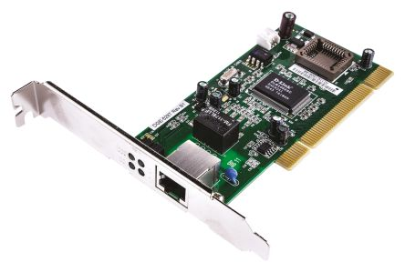
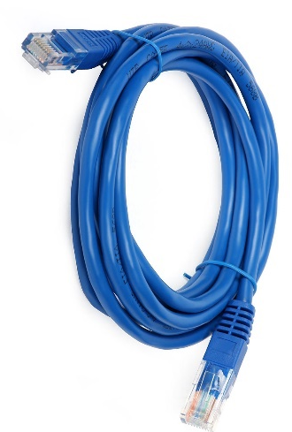
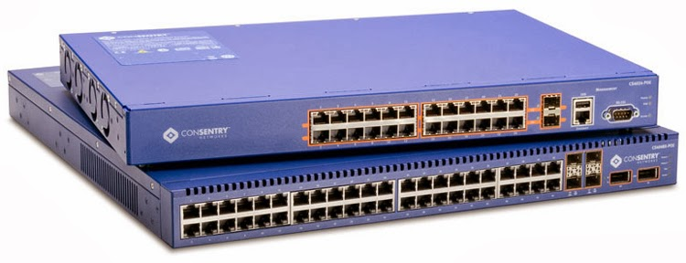
Network Hardware Components
To physically install a network, the following hardware is needed:
Network Interface Card
Cables/Links
Connectivity Devices

Slide 46
Network Hardware Components
That is our next lesson ☺

Slide 47
Research Activity
Briefly explain the different categories of UTP cables (CAT1, CAT2, …, CAT6), and identify which one(s) are commonly used nowadays in networking.
Explore and explain more types of network topologies other than those that were covered in the chapter.

Slide 48
Research Activity
Establish a peer-to-peer network using your Operating System (e.g. create a homegroup/workgroup on Windows). Use this network to print and exchange files among other peers. Each computer specifies its available resources (printer, files, folders, disk drives) and assigns their permissions for other peers. Don’t forget that a network must consist of two or more computers equipped with necessary hardware ☺.

